Slide 1
CONNECT 4 GAME Computer Science 2 Project
By: SYED MUHAMMAD SAIM
Electronic Engineering - Hamm-Lippstadt University Of Applied Sciences

Slide 2
Contents
Background
Use Case Diagram
Activity Diagram
Advanced Features
Conclusion

Slide 3
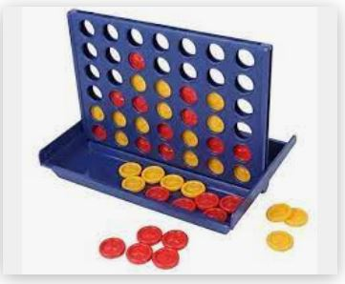
Background
6 rows
7 columns
2 colors
Place the mark column-wise
The first person who make 4 consistent connection will win (either vertically, horizontally or diagonally)

Slide 4
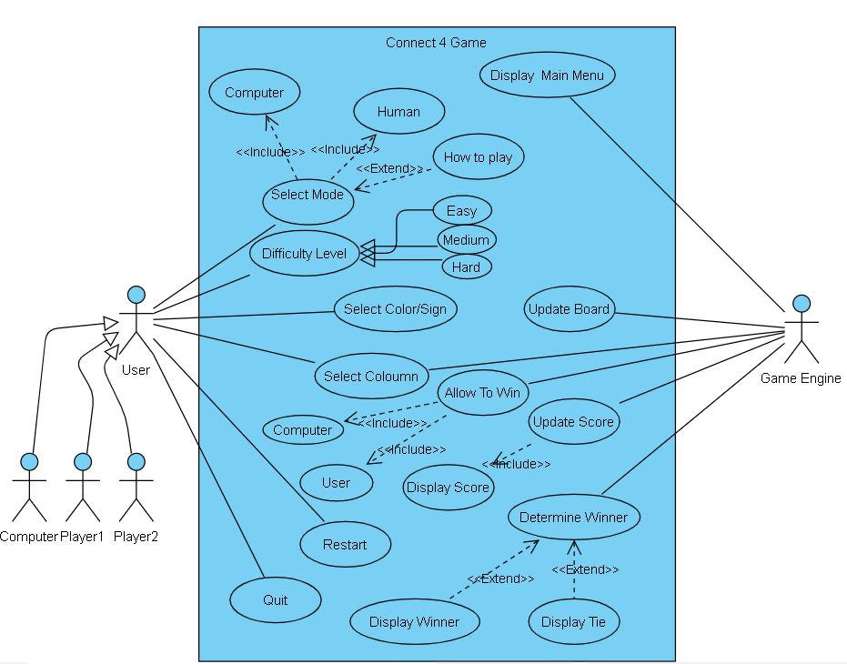
Use Case Diagram

Slide 5
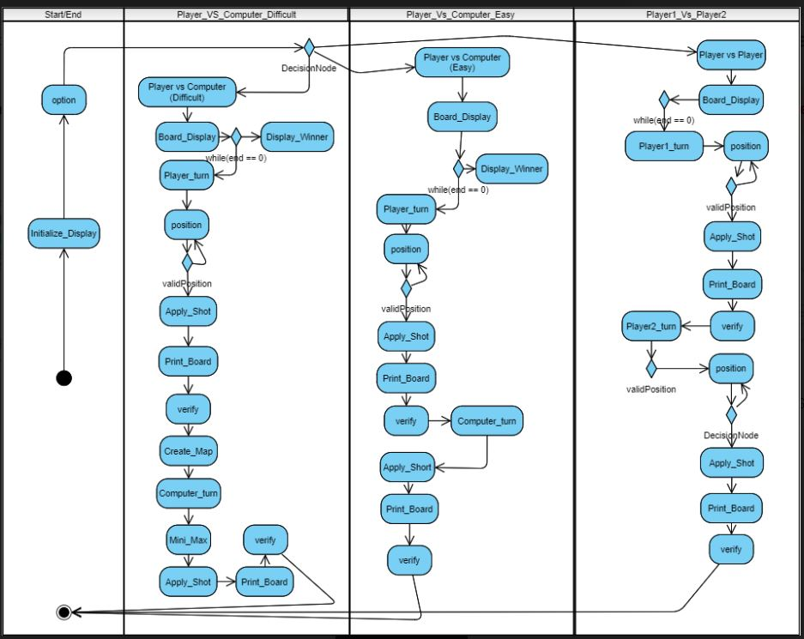
Activity Diagram

Slide 6
Program Information
Can be compiled on almost every IDE even the online.
75 KB

Slide 7
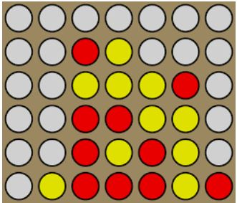
Advanced Feature
Graphics and Colors
Online
Computer vs Computer

Slide 8
Conclusion

